Slide 1
RDF and the OSM Datamodel
Introduction to interpreting OSM data to answer questions …

Slide 2
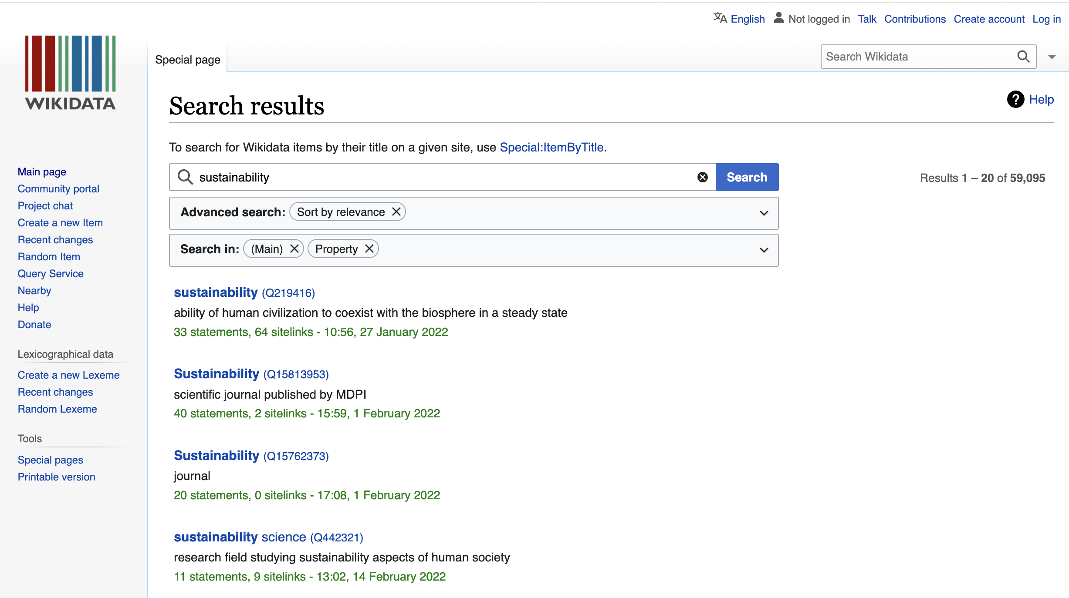

Slide 3
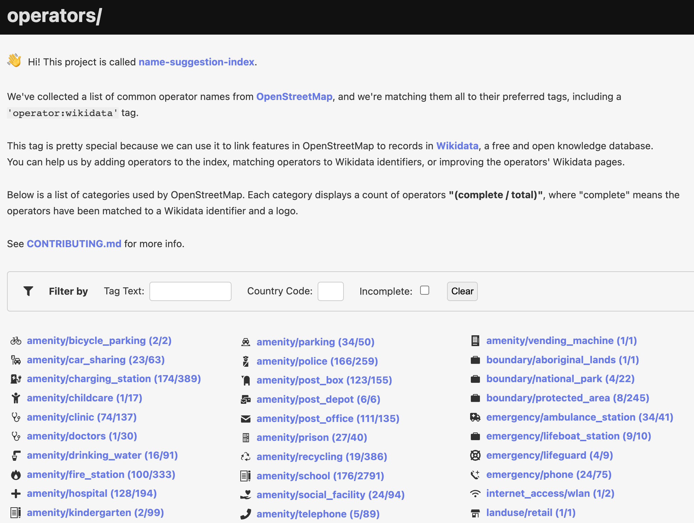

Slide 4
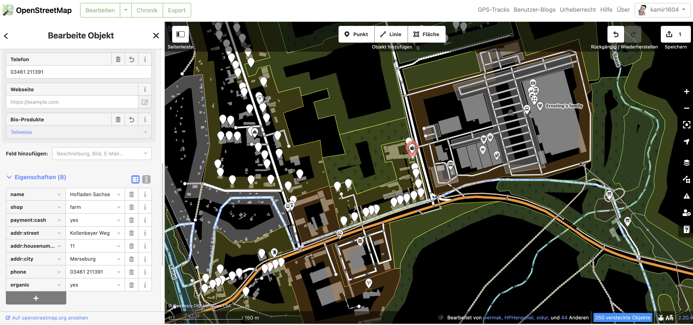

Slide 5
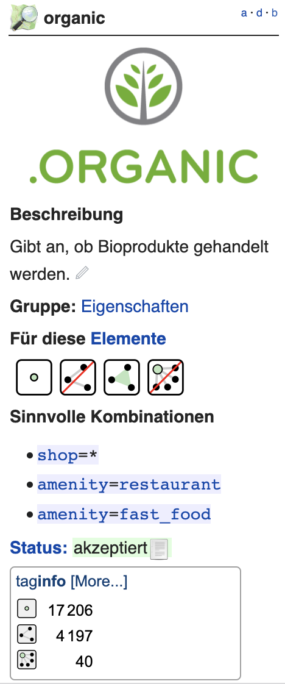
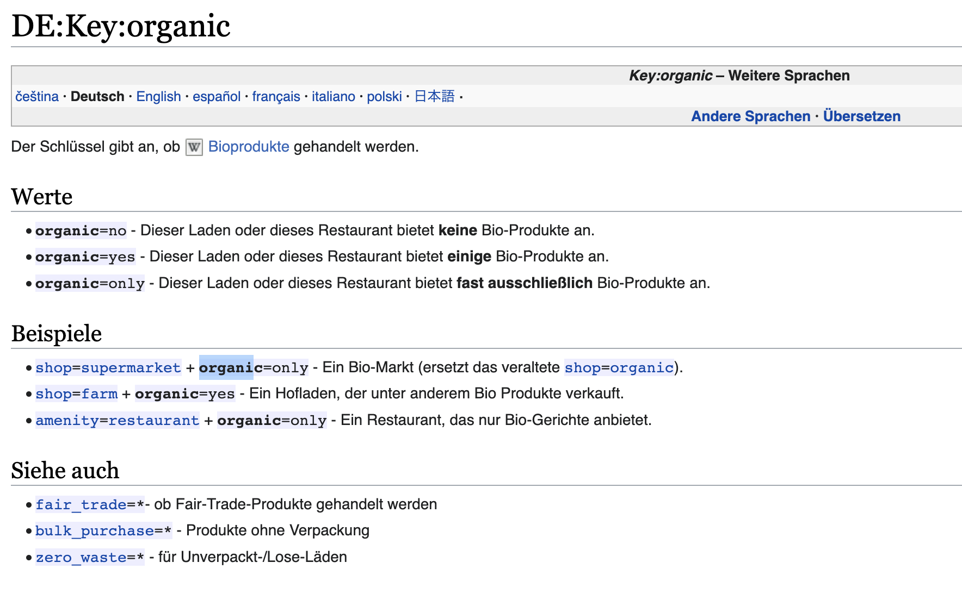

Slide 6
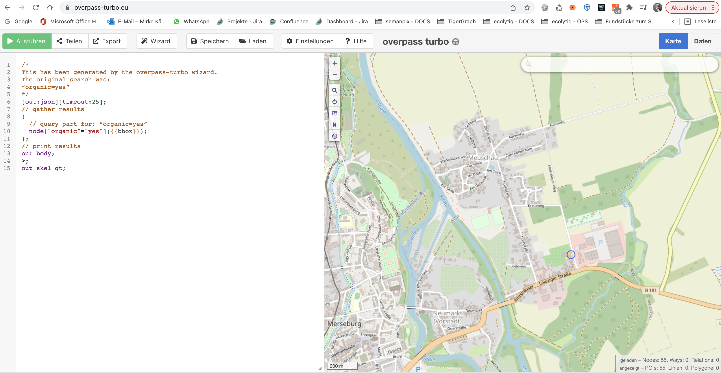

Slide 7
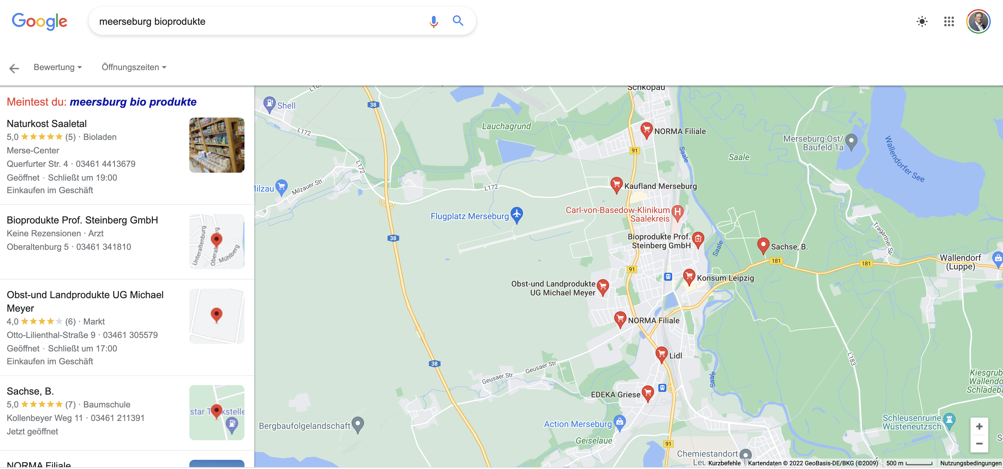

Slide 8
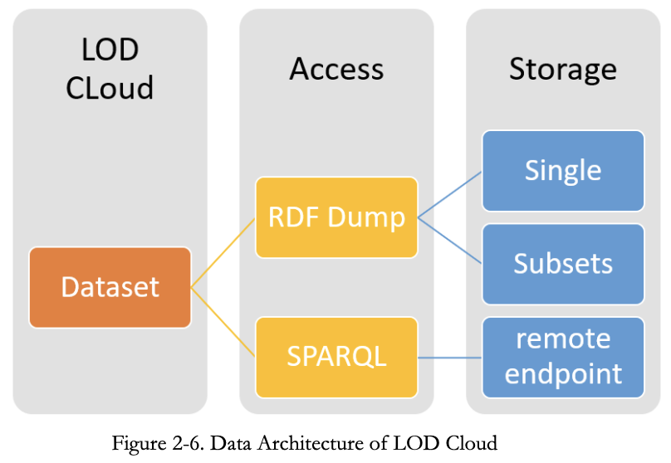
Notes:
file:///Users/mkaempf/Desktop/GeoQB/Linked_Spatial_Data_Beyond_The_Linked_Op.pdf

